Slide 1

Pandora: AI Counselor Bot
Developed by
Michelle De Melo
Radhika Dabholkar

Slide 2
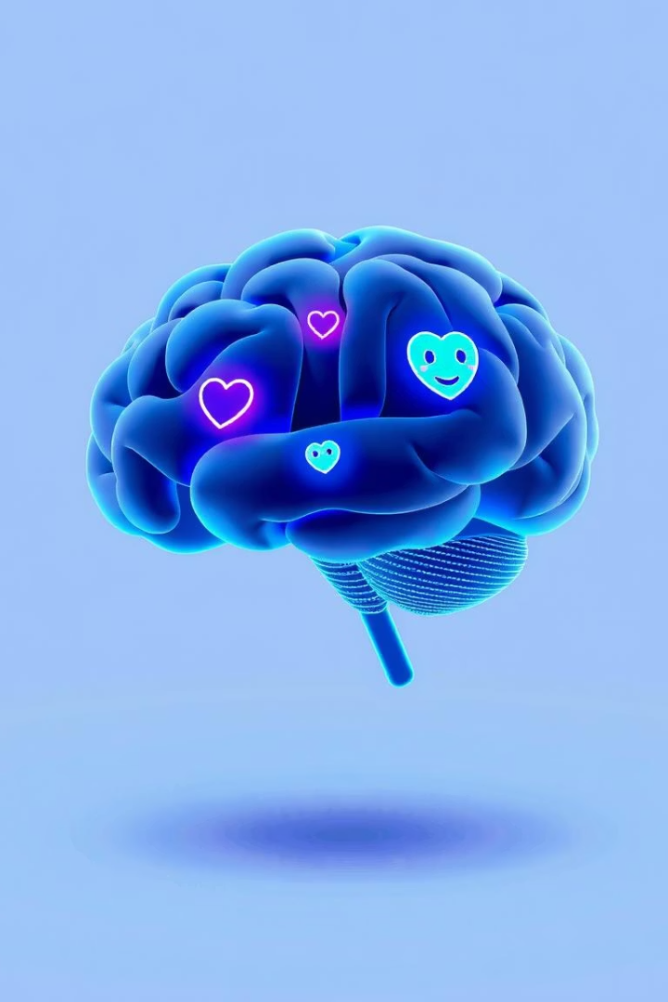
Abstract
Purpose
Focus
An AI counselor providing emotional support to students.
Helps with stress, loneliness, anxiety, and depression.
Approach
Combines Retrieval-Augmented Generation and optional fine-tuning.

Slide 3

Problem Statement
Challenges
Issues
Failure in handling sensitive conversations effectively.
Tendency to hallucinate inaccurate or harmful advice.
User Experience
Responses often sound robotic or emotionally distant.

Slide 4
System Architecture
User Input
Initial message submitted by user.
RAG Search
Retrieve relevant contextual information.
Warm Prompt
Generate empathetic prompt for response.
Fine-tuned Model
Produce accurate, safe reply.
Final Reply
Deliver thoughtful response to user.

Slide 5





Technologies Used
Python 3.10
HuggingFace Transformers
FAISS
Jupyter Notebook
Programming and AI model implementation language.
Efficient similarity search and retrieval.
State-of-the-art NLP model frameworks.
Interactive coding and experimentation environment.

Slide 6
Sample Chat Outputs
User:
Pandora:
I feel sad.
It's okay to feel sad. I'm here to listen.
I'm anxious.
Anxiety is normal. Deep breaths.
I feel like ending it.
Please reach out to someone you trust.

Slide 7
Challenges Faced
Fine-tuning on small dataset caused repetitive outputs
Sensitive mental health topics needed careful handling
FAISS retrieval sometimes returned irrelevant advice
OpenAI API limits led to switching to HuggingFace
Achieving empathetic, human-like tone was challenging

Slide 8

Conclusion
Emotional Safety
Hybrid Architecture
Pandora ensures secure handling of sensitive chats.
Combines retrieval and fine-tuning for factual replies.
Scalability
Designed to grow with future demands and features.

